Slide 1

TENSORFLOW

Slide 2

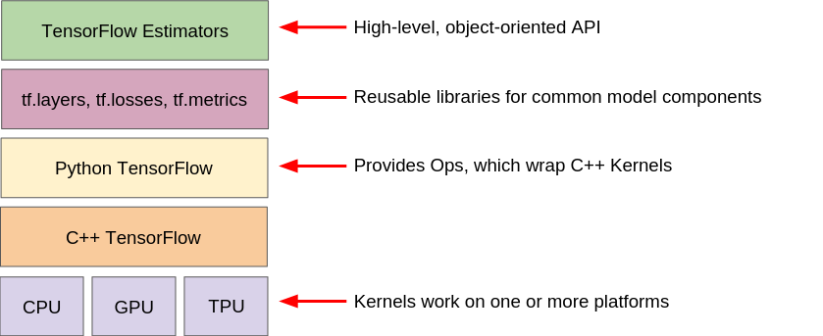

Tf.estimators
Tf.layers
Tf.losses
Tf.metrics
Python Tensorflow
C++ Tensorflow
CPU GPU TPU

Slide 3
FEATURES OF TENSORFLOW
Flexible
Easily trainable
Parallel neural network training
Open source
Availability of statistical distribution
Visualizer with tensor board

Slide 4
Some Tensorflow applications
Image classification
Text classification
Image recognition
Audio recognition

Slide 5
Some concepts
Embedding
- convert text to vectors and real numbers
- before get in to a neural network
convert vectors -> word
- neural network is created by stacking layers
Debugging
- tfdbg debugger
Train the model with tfdbg

Slide 6
Tensorflow lite
Tensorflow lite architecture
Trained tensorflow model
Tensorflow lite converter
Tensorflow lite model file (.tflite)
ANDROID app
Java api
C++ api
Interpreter
Neural network api
IOS app
C++ API
interpreter

Slide 7
THANKYOU

